Slide 1
CSc 553 Principles of Compilation 05. Program Analysis
Saumya Debray
The University of Arizona
Tucson, AZ 85721

Slide 2
Analysis and optimization: organization
front end
control flow analysis
code optimizer
data flow analysis
code transformations
code generator

Slide 3
Background

Slide 4
Background: Computability Theory
Program analysis ≡ programs reasoning about programs
what is possible? what are the limits?

Slide 5
Background: Computability Theory
History:
in the first half of the 20th century, a lot of researchers were trying to understand the capabilities and limits of mechanical computation
different people approached these questions from different angles using different formalisms
Alan Turing: "automatic machines" (now called Turing machines)
Alonzo Church: Lambda calculus
Stephen Kleene: General recursive functions
...

Slide 6
Background: Computability Theory
These formalisms turned out to be computationally equivalent
each could simulate the others
Consensus ["Church-Turing Thesis"]: These formalisms capture the notion of "algorithmically computable" functions
we can use these formalisms to study what can (and what cannot) be computed algorithmically

Slide 7
Undecidability
Turing proved that some problems are undecidable
i.e.: there is no algorithm that will, for all instances of the problem:
correctly solve that problem instance; and
terminate
This does not rule out:
algorithms that correctly solve some instances of that problem, and always terminate
computations that attempt to solve all instances of the problem, but sometimes don't terminate

Slide 8
Undecidability and program analysis
Rice's Theorem: All nontrivial behavioral properties of programs are undecidable
(a property is trivial if either all programs have it, or else no program has it)
This means:
we can have program analyses that produce safe (but sometimes imprecise) analysis results and always terminate
if we tried to always produce precise analysis results, the analysis would sometimes not terminate
**
compilers*
* people hate it when the compiler goes into an infinite loop
** "safe" means that all possible executions are accounted for in the analysis results (however, imprecision arising from undecidability means that the analysis can also account for executions that cannot actually occur at runtime)

Slide 9
Program analysis and precision
In general, we can expect precise results for some, but not all, input programs
The more work an analysis does, the larger the set of inputs for which it can be precise
all programs
the set of programs for which an analysis is precise
amount of work done

Slide 10
Control flow analysis

Slide 11
Goals
To obtain higher-level information about the possible control flow behaviors of the program, e.g.:
“which blocks are guaranteed to have been executed if control reaches some block B?”
“which blocks are guaranteed to be executed once control reaches some block B?”
“what is the loop structure of the code?”
Criteria:
must be “safe,” i.e., must take into account all possible executions of the program

Slide 12
Analysis and optimization: organization
front end
control flow analysis
code optimizer
data flow analysis
code transformations
code generator

Slide 13
Dominators

Slide 14
Dominators
Definition: A node d in a flow graph G dominates a node n (written “d dom n”) iff every path from the entry node of G to n contains the node d.
Facts:
every node dominates itself;
the “dom” relation is a partial order;
every node has a unique immediate dominator.
the dominator relationships in a flow graph form a tree (the “dominator tree.”)

Slide 15
Immediate Dominator
x is an immediate dominator of y iff:
x dom y; and
there is no z (z != x) such that x dom z and z dom y

Slide 16
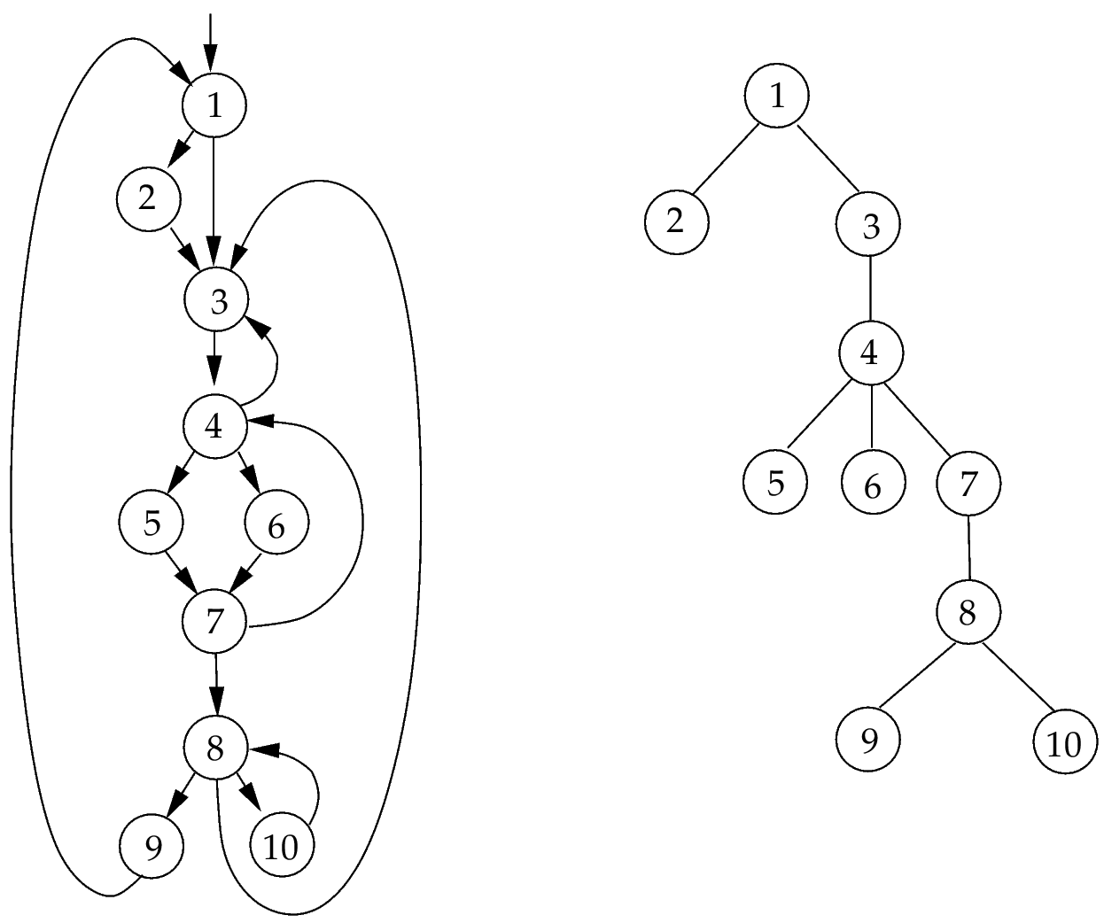
Dominator tree: Example
Control flow graph
Dominator tree

Slide 17
EXERCISE
What is the immediate dominator for:
F?
G?
H?
What is the set of dominators for:
G?
H?
I?
A
B
C
D
E
F
G
H
What happens to the set of dominators of node I if we add an edge H → I?
I

Slide 18
Finding dominators
Given: a flow graph G with set of nodes N and entry node n₀.
Algorithm:
for each node n, initialize D(n) =
repeat:
for each node n ∈ N – {n₀} do:
D(n) = {n} ∪ (⋂_{p ∈ preds(n)} D(p))
until there is no change to D(n) for any node n.
{n₀} | if n = n₀
N | otherwise

Slide 19
Natural loops

Slide 20
Natural loops
Definition: A loop in a flow graph is a set of nodes N satisfying:
N has a single entry point (the “header”) that dominates every node in N; and
each node in N is reachable from every other node in N.
Back edges:
A back edge in a flow graph is an edge a → b where b dominates a.

Slide 21
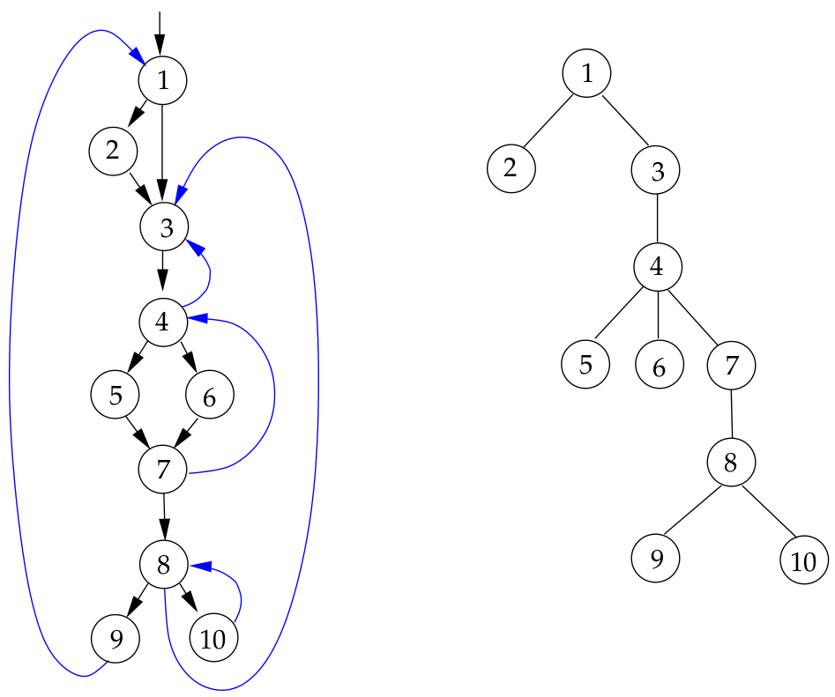
Examples of back edges
back edges

Slide 22
Identifying natural loops
Problem:
Given a flow graph G and a back edge e ≡ a → b in G, find the natural loop associated with e
Algorithm:
stack = NULL; loop = { b }; insert(a, loop); while stack not empty { m = pop(stack); for each predecessor p of m { insert(p, loop); } } | procedure insert(node n, nodeset L) { if ( n ∉ L ) { add n to L; push n on stack; } }

Slide 23
EXERCISE
What are the back edges in this graph?
For each back edge: which vertices are in its natural loop?
A
C
D
F

Slide 24
EXERCISE
What are the back edges in this graph?
For each back edge: which vertices are in its natural loop?
A
B
C
D

Slide 25
Data flow analysis

Slide 26
Dataflow analysis: goals
To infer invariants about the runtime behavior of programs
“what must be true, for any possible execution, whenever control reaches this point in the code?”
this information is then used for various purposes, e.g., optimizing transformations, security analyses, ...
Criteria:
must be “safe,” i.e., must take into account all possible executions of the program.

Slide 27
Analysis and optimization: organization
front end
control flow analysis
code optimizer
data flow analysis
code transformations
code generator

Slide 28
The Dataflow Analysis Landscape
flow tracking
cost,
precision
flow-
sensitive
considers instruction order
flow-
insensitive
does not consider instruction order
extent
local
global
inter-procedural
basic block level
function level
across function boundaries

Slide 29
Global dataflow analysis
Set up equations relating properties at different program points in terms of properties at other “nearby” points.
Usually, for each block B:
one equation expresses how the property is affected by the instructions in B;
one equation captures the effect of the flow of values across basic block boundaries.
We then solve these equations iteratively.

Slide 30
Analysis 1 Reaching definitions

Slide 31
Reaching definitions
x = …
y = …
which instruction(s) could have assigned to x and y at this point?
x = y+1
y = 2*y
≡
which assignments to x and y "reach" this point?
u = x+y

Slide 32
Reaching definitions
x = …
y = …
which instruction(s) could have assigned to x and y at this point?
x = y+1
y = 2*y
≡
which assignments to x and y "reach" this point?
u = x+y

Slide 33
Reaching definitions
x = …
y = …
which instruction(s) could have assigned to x and y at this point?
z = &x
z = &y
≡
which assignments to x and y "reach" this point?
*z = …
u = x+y

Slide 34
Reaching definitions
A definition of a variable x is an instruction that (may) assign a value to it
unambiguous definitions: definitely assign to x;
ambiguous definitions: may (or may not) assign to x, e.g., indirect stores, function calls
A definition of x is killed along a path π if x is (definitely) redefined somewhere along π
A definition d reaches a point p if there is some path π from d to p such that d is not killed along π

Slide 35
Computing reaching definitions
in[B] : definitions reaching B's entry
B
a basic block
gen[B] : definitions in B that reach the end of B
kill[B] : definitions that are killed by definitions in B
Idea: express out[B] in terms of in[B]
out[B] : definitions reaching B's exit
express how the code in B transforms in[B] to out[B]
gen[B]: definitions added to in[B]
kill[B]: definitions removed from in[B]

Slide 36
Reaching definitions: dataflow equations
out[B] = gen[B] ∪ (in[B] – kill[B])
in[B] = ∪ { out[X] | X is a predecessor of B}
gen[B]: | the set of definitions in B that reach the end of B
kill[B]: | the set of definitions (in the entire function) that are killed by definitions within B
in[B]: | the set of definitions that reach the entry to B
out[B]: | the set of definitions that reach the exit from B

Slide 37
Reaching definitions: dataflow equations
out[B] = gen[B] ∪ (in[B] – kill[B])
in[B] = ∪ { out[X] | X is a predecessor of B}
Points to note:
out[B] is computed from in[B]
in[B] computed from predecessors of B
information is propagated along direction of control flow
"forward dataflow analysis"
in the presence of loops, the equations become circular

Slide 38
Reaching definitions: gen and kill sets
For each block B: gen[B], kill[B] computed once, at the beginning, using information local to B:
.G = K = ∅;
for each instruction I in B, going forward, do:
let I ≡ ‘x = …’, and D_{x} = {J | J is an instruction defining x};
G = (G – D_{x}) ∪ { I }
K = (K ∪ D_{x}) – { I }
gen[B] = G at the end of B;
kill[B] = K at the end of B;

Slide 39
Solving dataflow equations
Choose an initial approximation for in[B], out[B].
Iteratively improve these approximations:
let in_{i}[B], out_{i}[B] be values obtained after iteration i.
recompute dataflow equations using these values:
out_{i+1}[B] = gen[B] ⋃ (in_{i}[B] – kill[B])
in_{i+1}[B] = ⋃ { out_{i}[X] | X is a predecessor of B}
until the equations converge, i.e., there is no change to in[B] or out[B] for any B.

Slide 40
Solving dataflow equations
for each block B, set out[B] = gen[B]; /* assumes in[B] = ∅ */
chg = true
while ( chg ) {
chg = false
for each block B {
in[B] = ⋃ { out[X] | X a predecessor of B };
oldout = out[B];
out[B] = gen[B] ⋃ (in[B] – kill[B]);
if (out[B] ≠ oldout) chg = true;
}
}

Slide 41
Implementation notes
The sets being computed range over a fixed domain (variables, instructions, etc.)
⇒ represent as bit vectors for efficiency.
Precompute gen[B], kill[B] as bit masks.
manipulate only in[B], out[B] during iteration.
Storing dataflow information for every program point requires too much space:
store in[B] and/or out[B];
recompute values for points within B as needed.

Slide 42
Analysis 2 Liveness analysis

Slide 43
Liveness analysis
Definition: A variable is live at a program point p if its value is (may be) used at a later point q without getting redefined between p and q.
Dataflow sets:
in[B], out[B] : the set of variables live at entry to/exit from B;
def[B]: the set of variables definitely assigned to within B before being used;
use[B]: the set of variables that may be used in B prior to being defined.

Slide 44
Liveness analysis: def and use sets
For each block B: def[B], use[B] are computed once, at the beginning, using information local to B:
D = U = ∅;
for each instruction I in B, going backward from the end, do: /* compute D, U immediately before I */
let I ≡ ‘x = y ⊕ z’;
D = (D ∪ { x }) – { y, z };
U = (U – { x }) ∪ { y, z };
def[B] = D at the beginning of B;
use[B] = U at the beginning of B.

Slide 45
Liveness analysis: equations and algorithm
in[B] = use[B] ∪ (out[B] – def[B])
out[B] = ∪ { in[X] | X is a successor of B }.
Algorithm:
for each basic block B, set in[B] = use[B];
repeat
for each basic block B {
out[B] = ∪ { in[X] | X is a successor of B };
in[B] = use[B] ∪ (out[B] – def[B]);
}
until no change to in[B], out[B] for any B.

Slide 46
Analysis 3 Available expressions

Slide 47
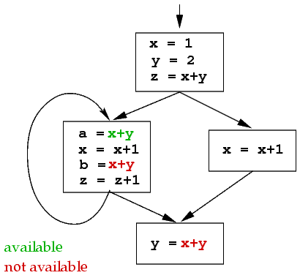
Available expressions
Definition: An expression e is available at a point p if:
e is evaluated on every path from the entry node to p (incl. cyclic ones); and
the variables in e are not redefined after the last such evaluation.
If e is available, it need not be recomputed.

Slide 48
Available expressions: dataflow equations
in[B], out[B]: sets of expressions available at B’s entry/exit.
gen[B]: the set of expressions e that are evaluated in B, s.t. no variable in e is redefined after the last evaluation of e in B.
kill[B]: the set of expressions e in the program (function) s.t. B may redefine some variables in e without subsequently evaluating e.
in[B₀] = ∅ (B₀ is the entry node)
in[B] = ∩ { out[X] | X a predecessor of B} if B ≠ B₀
out[B] = gen[B] ∪ (in[B] – kill[B])

Slide 49
Available expressions: gen and kill sets
For each block B: gen[B], kill[B] computed once, at the beginning of the analysis, using information local to B:
G = K = ∅;
for each instruction I in B, going forward, do:
let I ≡ ‘x = y ⊕ z’, and E_{x} = all expressions involving x;
G = (G ∪ { ‘y ⊕ z’ }) – E_{x};
K = (K – { ‘y ⊕ z’ }) ∪ E_{x};
gen[B] = G at the end of B;
kill[B] = K at the end of B;

Slide 50
Available expressions: Algorithm
Let U be the set of all expressions appearing on the RHS of some instruction in the function.
in[B₀] = ∅;
for each block B, set out[B] = U – kill[B];
repeat
for each basic block B {
in[B] = ∩ { out[X] | X a predecessor of B };
out[B] = gen[B] ∪ (in[B] – kill[B]);
}
until no change to in[B], out[B] for any B.

Slide 51
Comparing different analyses

Slide 52
Reaching definitions vs. Available expressions
Modality:
d reaches p if it can reach p without getting killed along some path ( ∃-analysis ).
information merge operator: ∪
initial estimates set too small.
e available at p if e evaluated, not killed along every path to p ( ∀-analysis ).
information merge operator: ∩
initial estimates set too large.
Direction: both are forward analyses.
out[B] computed from in[B] (using gen, kill);
in[B] computed from out sets of predecessors of B.

Slide 53
Reaching definitions vs. Liveness Analysis
Modality: both are ∃-analyses:
merge operator: ∪
initial approximations are too small.
Direction:
reaching definitions: forward analysis
out[B] defined in terms of in[B];
in[B] defined in terms of out-sets of predecessors of B.
liveness analysis: backward analysis
in[B] defined in terms of out[B]
out[B] defined in terms of in-sets of succesors of B.

Slide 54
Families of dataflow analyses
Analyses can be classified in terms of modality (∀ or ∃) and direction (forward or backward).
These aspects of an analysis define
the structure of the dataflow equations;
the merge operator;
the nature of the initial approximations.
 | ∃ | ∀
forward | reaching defns. | available exprs.
backward | variable liveness | ?

Slide 55
Analysis 4 Constant propagation

Slide 56
Analysis 4. Constant propagation
Goal: Identify each expression e that can be guaranteed to evaluate to some fixed constant n_{e} for all possible executions of the program.
Motivation: Avoid runtime evaluation of expressions that can be evaluated at compile time. E.g.:
#define N 100
…
p = (int *) malloc( N*N*sizeof(int) );
for (i = 0; i < N*N; i++) {
p[i] = 0;
}

Slide 57
Constant propagation: Approach
Intuition: Compute an (over-)estimate of the set of values that can be taken on by an expression.
but we really only care about whether or not this set of values is a singleton

Slide 58
Constant propagation: Approach
Intuition: Compute an (over-)estimate of the set of values that can be taken on by an expression.
but we really only care about whether or not this set of values is a singleton
⊤ (no value assigned)
…
{‒3}
{‒2}
{‒1}
{0}
{1}
{2}
{3}
…
⊥ (value may not be a constant)

Slide 59
Constant propagation: Intuition
x ↦ {3}
y ↦ {4}
u ↦ {5}
x ↦ {3}
y ↦ {4}
u ↦ {7}
x = 3
y = 4
z = x+y
x ↦ {3}
x ↦ {3}
y ↦ {4}
u ↦ ⊥
y ↦ {4}
B
z ↦ {7}
z = x+y
v = u+1
z ↦ {7}
v ↦ ⊥
If all the variables in an expression have constant values, then the expression also has a constant value
A variable x is a constant n at the entry to B iff x is the same constant n at the exit of each predecessor of B

Slide 60
Constant propagation: Algorithm
Initialization: for each variable v, set v ↦ ⊤
Iterate until no change:
for each instruction I ≡ ‘x = y ⊕ z’ in each block in order:
if y ↦ ⊤ or z ↦ ⊤ before I, set x ↦ ⊤ after I
else if y ↦ n_{y} and z ↦ n_{z} before I, and ‘n_{y} ⊕ n_{z}’ is a constant n_{x}, set x ↦ n_{x} after I
else set x ↦ ⊥ after I
propagate constants across block boundaries. At each block B:
for each variable x, if ∃n_{x} : x ↦ n_{x} at the end of each predecessor of B, then x ↦ n_{x} at entry to B

